Slide 1




Slide 2
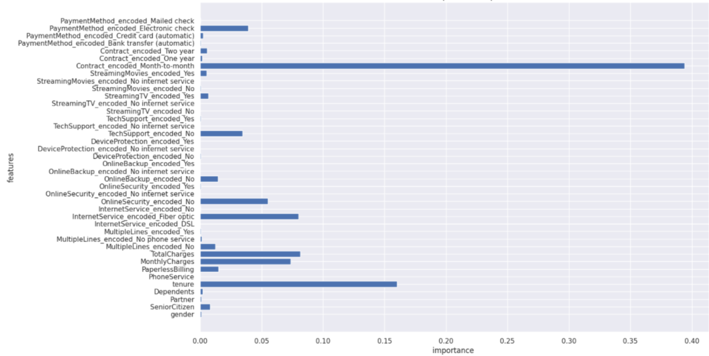
Feature Importance - Gradient Boosting Classifier

Slide 3
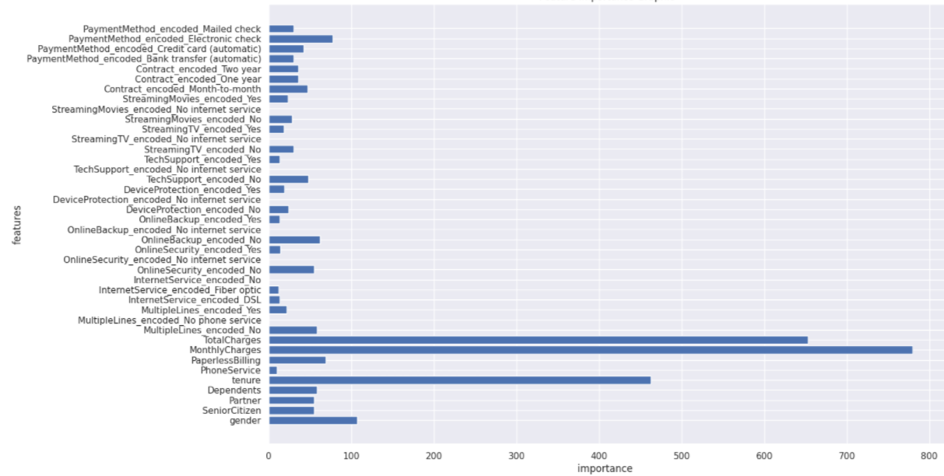
Feature Importance – Light GBM

Slide 4




Gender
Partner
Dependents
Phone Service
Multiple Lines
Internet Service
Online Security
Online Backup
Device Protection
Tech Support
Streaming TV
Streaming Movies
Contract
Paperless Billing
Payment Method
Churn

Slide 5



Internet Service
Streaming Movies
Contract

Slide 6
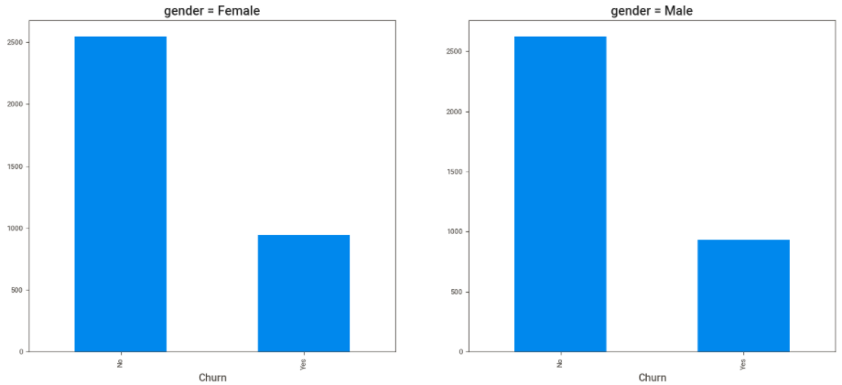
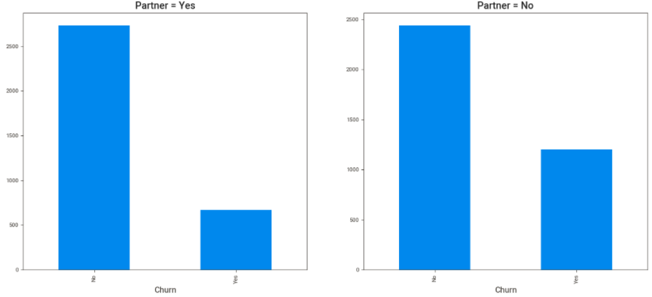
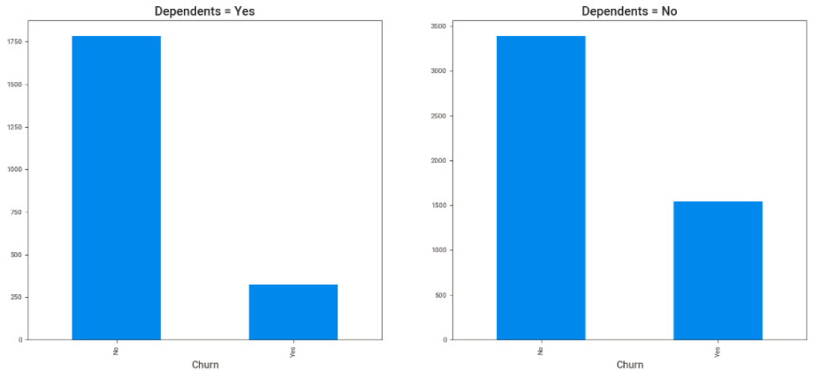
Gender
Partner
Dependents

Slide 7






















Slide 8
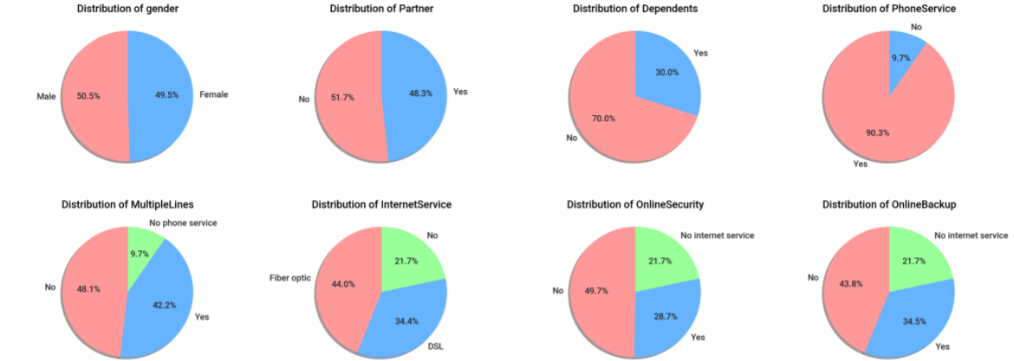
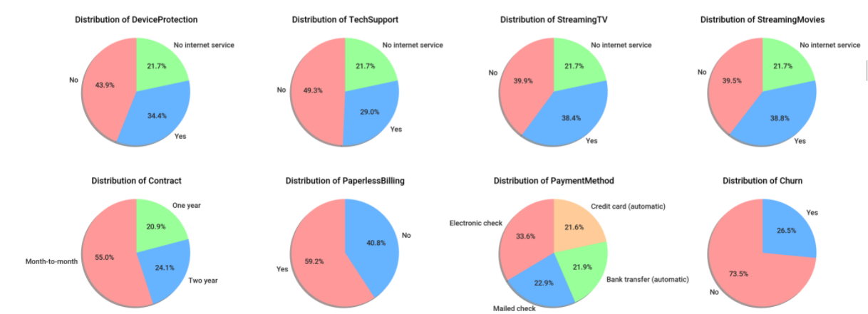

Slide 9
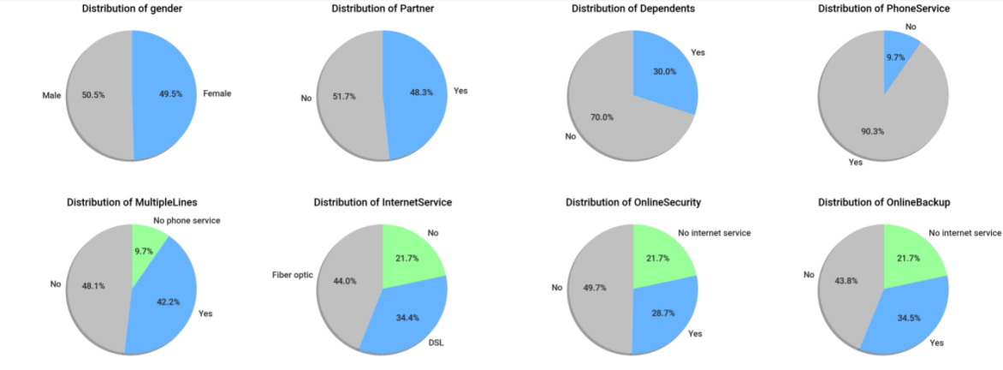
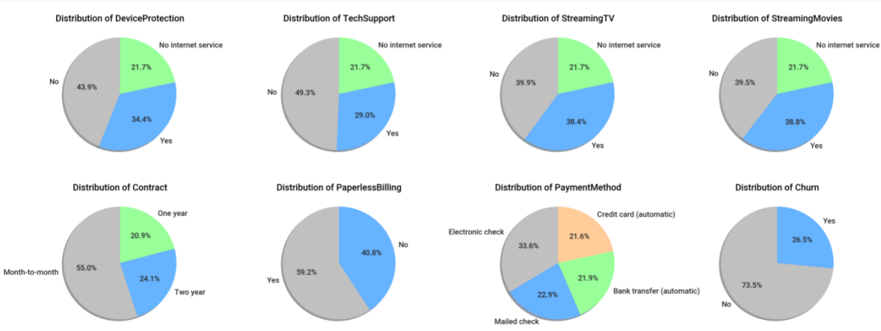

Slide 10
